Slide 1
Exam 1 Sample Questions

Slide 2
Exam Format
Open Book, Open Notes
Exam open on eLearning at 1.00 pm and close at 3.45 pm.
50 Questions, 5 points each. Total 250 points.
Multiple Choice Questions
No R Coding. Can use R if needed.
Plagiarism and cheating will not be tolerated.

Slide 3
Topics for the Test
The Basics: Supervised/Unsupervised, Regression/Classification
Data Exploration and Visualization
Data Preparation
Evaluating Performance Measures
Multiple Linear Regression
Logistic Regression

Slide 4
The Basics
Given a scenario, identify what kind of model is needed.
Supervised vs. Unsupervised
Prediction vs. Classification
Process/Model development lifecycle
Question:
Classifying emails as spam or not spam is an example of a supervised learning problem.
A) True
B) False
Notes:
Correct Answer: A) True

Slide 5
Variable Types
Continuous, Categorical, Dummy Variables, Ordered/Unordered
Question:
One Hot Encoding is a process to:
A) Convert missing values in a column to 1s.
B) Convert non-numeric categorical values in a column into numeric representations.
C) Convert numeric values in a column into non-numeric categorical values.
D) Convert 0s into 1s.
Notes:
Correct Answer: B) Convert non-numeric categorical values in a column into numeric representations.

Slide 6
Data Preparation
Missing values, scaling, normalization, categorical variables, etc.
Question:
Which of the following is a common step in data preparation before building a predictive model?
A) Removing all numeric variables from the dataset.
B) Splitting the data into training and validation sets.
C) Converting numeric values to text format for easier analysis.
D) Randomly changing the values of categorical variables.
Notes:
Correct Answer: B) Splitting the data into training and validation sets.

Slide 7
Data Preparation
Which of the following is NOT a common method for normalizing data?
Subtracting the mean and dividing by the standard deviation
Subtracting the minimum and dividing by the range
Subtracting the median and dividing by the interquartile range
Multiplying each value by 2
Notes:
Answer: D
Multiplying each value by 2 is not a method for normalizing data. The purpose of normalization is to scale the data, and this method does not achieve that aim.

Slide 8
Data Understanding
In the context of model building for multiple linear regression, what is multicollinearity?
It refers to the correlation between the error terms
It refers to a high correlation between two or more predictors
It refers to the correlation between each predictor and the dependent variable
It refers to multiple cycles or trends in the data
Notes:
Answer: B
Multicollinearity occurs when two or more predictors in a multiple regression model are highly correlated, making it difficult to isolate the effect of each predictor on the dependent variable.

Slide 9
Sampling
Which of the following best describes the purpose of oversampling in a classification problem?
To reduce the number of instances in the majority class.
To increase the number of instances in the minority class.
To randomly partition the data into training and test sets.
To select a subset of features for the model.
Notes:
Answer: B

Slide 10
Linear Regression
If a model has an RMSE value very close to 0 on the training data, what potential issue should you be cautious of?
Underfitting
Overfitting
High Bias
Low Variance
Notes:
Answer: B
Explanation: If a model has a very low RMSE on the training data, it suggests that the model is fitting the training data extremely well, possibly capturing noise or patterns that don't generalize to new, unseen data. This is a sign of overfitting, where the model performs exceptionally on the training set but may fail to predict accurately on the validation or test sets.

Slide 11
Linear Regression
What is the primary purpose of the Adjusted R² metric in the context of multiple linear regression?
It measures how well the model generalizes to new data
It adjusts R² for the number of predictors in the model
It represents the percentage of the variance in the dependent variable explained by the model
It adjusts the R² value to account for sample size
Notes:
Answer: B
The Adjusted R² metric takes into account the number of predictors in the model, providing a more accurate measure of goodness-of-fit, especially when multiple predictors are used.

Slide 12
Linear Regression Model Performance
You are comparing two linear regression models: Model A with an R² of 0.85 and an Adjusted R² of 0.82, and Model B with an R² of 0.86 but an Adjusted R² of 0.81. Both models were developed using the same dataset. Which model is likely better, and why?
Model A, because it has a higher Adjusted R²
Model B, because it has a higher R²
Model A, because it has a smaller gap between R² and Adjusted R²
Cannot determine without knowing the number of predictors in each model
Notes:
Answer: D
Cannot determine without knowing the number of predictors in each model.

Slide 13
Linear Regression : Computation
You have a multiple linear regression model that predicts the final exam score of a student based on the number of hours they studied, their midterm exam score, and the number of assignments they completed. The coefficients for these predictors are 1.2, 0.5, and 2.0 respectively, and the intercept is 10.
What would be the predicted final exam score for a student who studied for 30 hours, scored 80 on the midterm, and completed 5 assignments?
90
115
102
96
Notes:
Answer: D
Predicted Score=10+(1.2×30)+(0.5×80)+(2.0×5)

Slide 14

Logistic Regression
In logistic regression, what is the range of the log-odds function
(−∞,+∞)
(0,1)
(0,+∞)
(−∞,0)
Notes:
Answer: A

Slide 15
Logistic Regression
Which of the following is not an assumption of logistic regression?
The dependent variable is binary.
The independent variables are linearly related to the log-odds of the dependent variable.
The error terms must be normally distributed.
There is no multicollinearity among the independent variables.
Notes:
Answer: C
Logistic regression does not assume that the error terms are normally distributed, which is a key assumption in linear regression, not logistic regression.

Slide 16
Confusion Matrix
Let's consider a binary classification problem where we are classifying emails as either "Spam" or "Not Spam". “Spam” is the important class (C₁).
What is the True Positive rate (Sensitivity) based on the given confusion matrix?
0.875
0.833
0.909
0.769
 |  | Predicted
 |  | Not Spam | Spam
Actual | Not Spam | 50 | 10
 | Spam | 5 | 35
Notes:
Answer: A
Sensitivity (True Positive Rate) = TP / (TP + FN) = 35 / (35 + 5) = 35 / 40 = 0.875
Related topics: Overall error rate, Accuracy, Sensitivity, Specificity, Precision

Slide 17
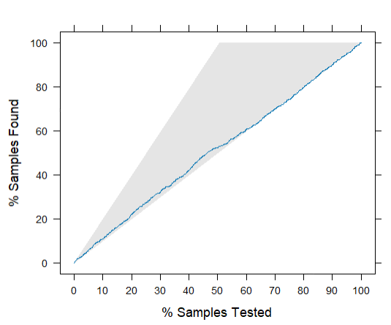
Lift Chart
Here’s a lift chart created for a classification model using caret package in R.
After testing ___% of the samples, ___% of the actual positives have been identified by the model.
25, 25
60, 90
80, 20
50, 100
Notes:
Answer: D
Related topics: Lift chart using gains package, Decile Chart

Slide 18
Logistic Regression : Computation
You have a logistic regression model that predicts the likelihood of a student passing an exam (positive class: pass, negative class: fail) based on their hours of study, attendance, and whether they completed the homework. The coefficients for these predictors are 0.12, -0.8, and 0.9, respectively, and the intercept is -1.2.
What is the probability that a student who studied for 20 hours, has 90% attendance, and completed the homework (coded as 1) will pass the exam?
72.1%
88.4%
54.7%
79.9%
Notes:
Answer: D
logit(p)=−1.2+(0.12×20)+(−0.8×0.9)+(0.9×1) = 1.38
P = 1 / (1 + e^-logit(p) ) = 1 / 1 + 0.252 = 79.9

Slide 19
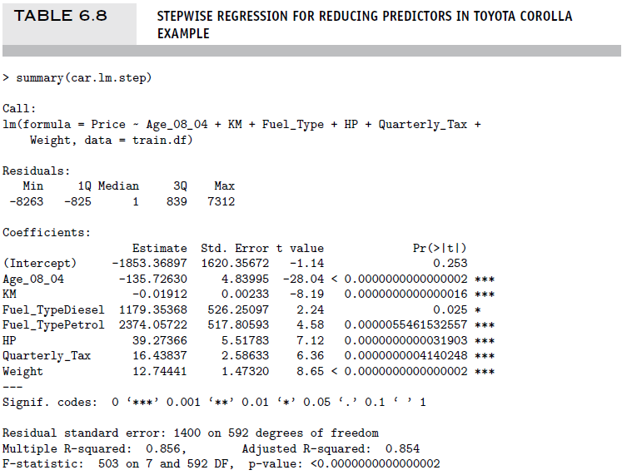
Linear Regression : Model Usage
Notes:
Predict the price of a car that is 36 months old, uses petrol, has a HP of 120, pays quarterly tax of 560, weighs 900 and has 55123 km on it.
What does the negative sign of KM indicate?
Coefficient of Age is -28.04. How would you interpret it?

Slide 20
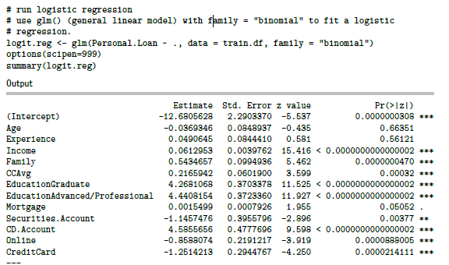
Logistic Regression : Model Usage
Notes:
What is the Odds of a customer, whose age is 50, has 20 years of experience, income of 180, family size of 4, CCAvg of 5, Education of Advanced/Professional level, and Mortgage of 55, accepting the personal loan offer?
The customer specified in question (#40) will accept the personal loan offer (at a decision threshold of 0.5).
What does the coefficient value of -1.25 for the variable CreditCard mean?

